Slide 1

Contact Management System
By:
AMIT KUMAR 190

Slide 2

Introduction
The telephone solved the problem of long-distance communication, but introducing better tools for organizing, finding and sharing the phone numbers themselves took more evolution of documentation and directories. Notebook records remained a holdover until better systems prevailed.

Slide 3
Problems
Numbers changed frequently
Illegible handwriting
Difficulty sharing
Numbers
Losing or damaging the notebook
Less portability

Slide 4





CMS app used:
Built in contacts app
38% of people rely on the built-in contact app on their phone
Google contacts
32% use Google Contacts
Apple’s iCloud
12% use Apple's iCloud
Microsoft outlook
8% use Microsoft Outlook
Others
5% use apps designed specifically for contact management

Slide 5

Contact Management System
In today's fast-paced world, managing contacts efficiently is crucial for personal and professional success. The Contact Management System is designed to streamline this process, providing a user-friendly and organized solution for handling contacts.

Slide 6
Areas of focus
B2B market scenarios​
Develop winning strategies to keep ahead of the competition
Capitalize on low-hanging fruit to identify a ballpark value
Visualize customer directed convergence
Cloud-based opportunities
Iterative approaches to corporate strategy
Establish a management framework from the inside

Slide 7
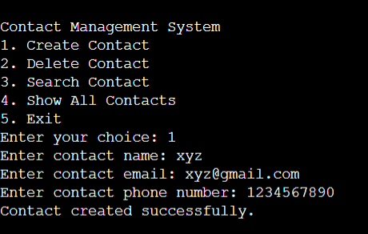
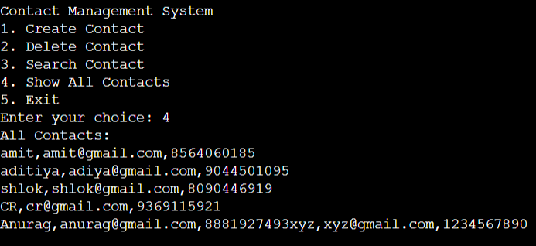
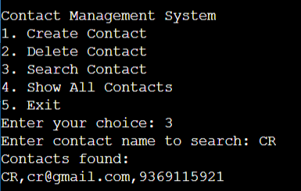
Output:

Slide 8
Any fool can write code that a computer can understand. Good programmers write code that humans can understand.
“
”
Martin Fowler

Slide 9

Thank you
Amit Kumar
@Amitm0v Github

